Slide 1
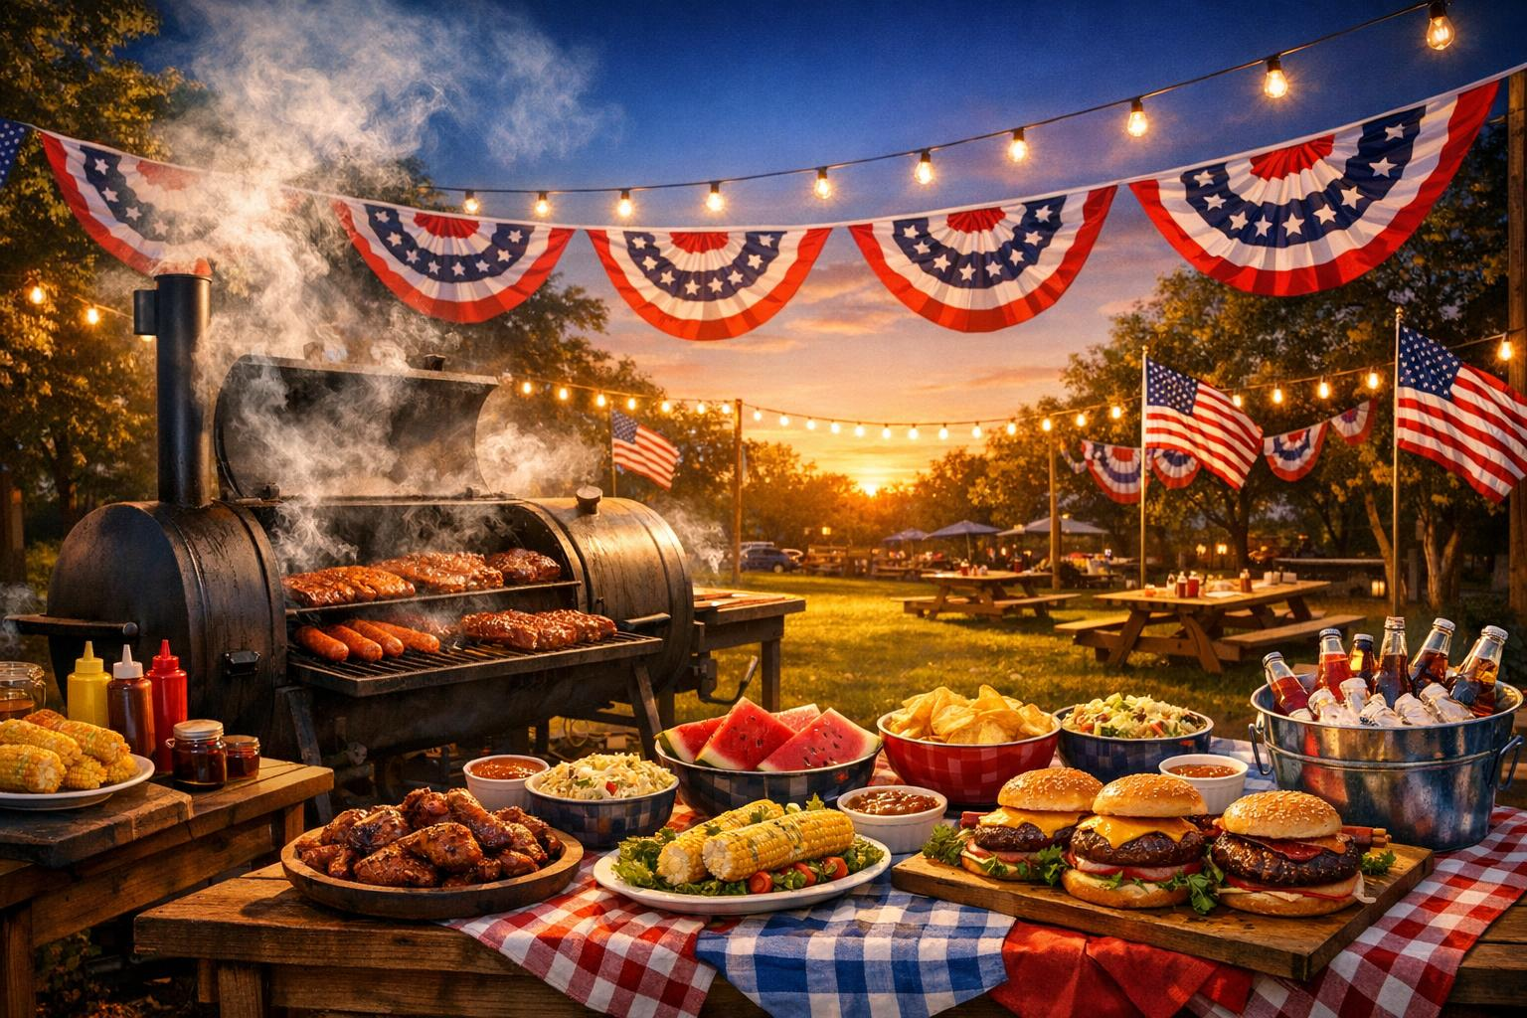
★ ★ ★ ★ ★ ★ ★ ★ ★
Smithfield V.F.W. Post 8545
ANNUAL FUNDRAISER
Saturday, June 20th 11:00 am – 3:00 pm
Location: Corner of Main Street and Route 10
★ ★ ★
Charcoal Slow Cooked
Boston Butts, $40.00
All proceeds support local veterans
Pork Butts generously
donated by Smithfield Foods
PLACE YOUR ORDER TODAY • CALL (208) 590-3925
Feed Your Family & Support Veterans in your Community

